Slide 2


Slide 4
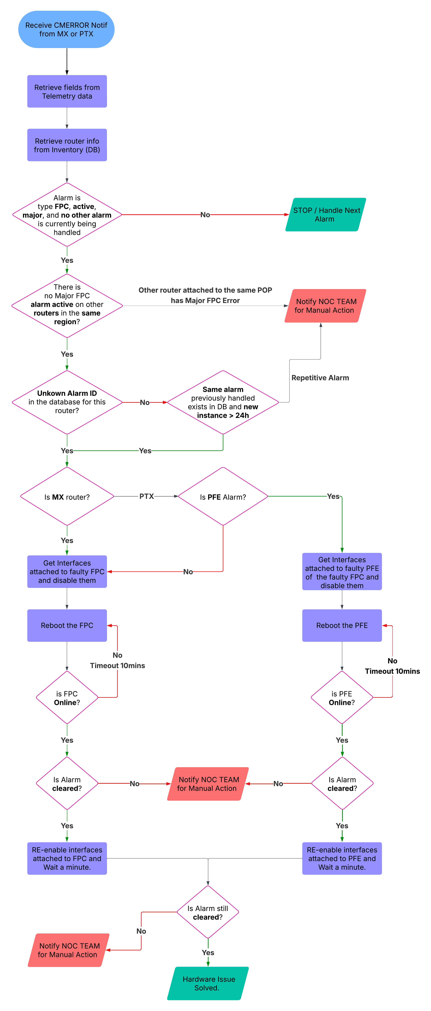

Slide 6
Juniper PowerPoint icons

Slide 7





















AI / AI-native
Right data
Right infrastructure
Microservices cloud
Right response
Right response
Networks for AI workloads
AI for Network Ops
Right secure infrastructure
AI
AI engine
Machine learning
Deep learning algorithm
AI Innovation
Self-drive car
Identity, authentication
QKD - Quantum Key Distribution
Test automation
Automated Secure Data Center
Automation
Industrial automation
Translation

Slide 8





































People
Generic user
Male user
Female user
Programmer
Hacker
CEO
CEO
Assistant
Cell phone user
Leadership
Management
Teamwork, collaboration
Talent finder
Resource gap
Employee opportunity
Employee opportunity
Ownership
Mask
Intelligence/ expertise
Confidence
Focus

Slide 9





































Devices
Cell phone
Tablet
Virtual reality
Data center
Cooling
High Performance Storage
Virtual server
Access server
App server
Data server
Database server
ATM machine
Kiosk
Medical monitor
Medical monitor
QR code scanner

Slide 10

























Enterprise / verticals / industry
Enterprise
Enterprise WAN
Enterprise Data
Headquarters
Campus/branch
Healthcare
Higher education
K-12 Education
Home
Bank
Manufacturing
Electric substation
Water
Nuclear
Retail
Warehouse
Electricity
Oil/gas
Home office
Hospital
Local gov
Federal gov
State gov
Government Defense & IC (CIA, NSA, DIA), Pentagon
Hotel

Slide 11






























Business
Trust, governance
Partner
Decision
Decision
Fortune 500
Compliance
Increase pipeline
Growth
Advertising
Contract
Founded
Strategy
Target
Missed target
Secure information
Cashflow
Decrease
Growth
Document
Launch
Foundation
Opportunities
Calendar
Scheduler
Customer success
Experience-first
Cross sell
Blog
Podcast
Process/
road map

Slide 12



































Finance
Increase in Opex
Reduction in Opex
Business operations
Digital business
Annual Recurring Revenue (ARR)
Cash flow/ sales cycle
Hedge gains
Dividends
Gross margin
Business enablement
GTM business focused
Multivendor integration
Challenges
Game plan
Verticals
Digital value chain
Americas
EMEA
APAC
TCO -Total Cost of Ownership
Price cut
Bitcoin

Slide 13
























Data / analytics
Telemetry
Response rate,
participation
Data analytics
Data analytics
Data driven
Enterprise data governance
Investment thesis and valuation
Stagnant revenue,
fixed fee/rate
Decrease
Product
Distribution
Deliver, care
Service

Slide 14




































Cloud
Cloud
Multicloud
Public cloud
Cloud provider
Cloud provider SDN
Cloud provider optical
Cloud provider DC
Cloud-ready DC
Global cloud provider
Cloud management
Cloud networking
IP infrastructure
Cloud location services
Cloud first
Secure cloud
Secure automated cloud
Telco/Edge cloud
Open APIs
Cloud computing
Edge cloud
Edge computing
Cloud agility
Virtual machine
Multicloud applications
Cloud data
Multicloud data
Cloud routing
Service provider
Service provider edge
Service provider metro
Service provider access
Cloud provider core
Cloud provider edge
Deployment
Cloud delivered enterprise
Enterprise multicloud

Slide 15
























Security
Security
Secure device
Web security
Secure automation
Visibility
Limited visibility
Vulnerability scan
Monitoring
Refract
Firewall
Virtual firewall
Data security
Cyber security
Threat warning
ID
Threat detection
Virus
Ransomware
Sandbox
Malware/phishing
Malicious email
Payload crafting

Slide 16






















Networking
Networking
World wide web/internet
Secure network
Connectivity
Network management
Network architecture
SDN
WAN
SD-WAN
WAN assurance
Automated WAN
Wired network
NaaS
Migrate
Exchange/ integration
Upgrade
Scalable IP fabric
IP-Optical Convergence
Service mesh
Service endpoint
NFP web service
Home services

Slide 17




































Wireless
Access point
Electronic banking
Mobile shopping
Smart city
Speed
Speedometer
Capacity
Indoor location
CPE antenna
SIM card
Key management
Wi-Fi assurance

Slide 18





























Programming
Code / software
Programmability
Data creation/ scripts
Data
Data, root cause analysis
Metadata
Monitor & remediate
Architecture
Tunnel free architecture
Scalable
Adaptative
Resilient/resilience
Application-led
Service-led, VNF led
Platform-led
Technology company
System patching
Digital tween
3rd party integration
Software/app
Native VPN integration
Encapsulated
Push not pull
Collectors
Containers
Operational excellence
Transform
Automation
Automation

Slide 19































Sustainability
Sustainability
Sustainability
Circular economy
Global warming
Reduce CO2,
Less emissions
Renewable, reusable energy
Clean water
Sustainable product
e-waste
Waste reduction
Waste generated in operations
Agriculture
Sourcing
Cloud Metro Sustainability
Sustainable Operations
Sustainable Systems
Sustainable Architecture

Slide 20






















Transportation
Logistics
Logistics and navigation
Logistics
Supply chain
Backlog
Generic
Police/
self drive car

Slide 21




































Generic
Inclusion/diversity
Diversity
Connection
Teamwork,
inclusion
Empathy, nurture
Win
Ideas
Ideas
3D
Celebration, fun
Longevity
Education
Web training
Wellbeing
Mindfulness
Juniper Voice
Community
Simplify
Play video

Slide 22

























Generic
False positive

Slide 23






































Switches/routers
Generic logical router
Generic secure router
MSC
SBC, GGSN
FCoE router
FCoE-FC router
FC router
FCoE-FC gateway
L2-L3 switch
Virtual switch
SGSN
RNC, gigabit ethernet, MPLS, SGSN, BSC
Load balancer
Dial access, ROADM MUX
MSAN access node DSLAM
DWDM
SONET switch
Voice Soft switch
SBC
BSR-VSR
Voice gateway
VoIP gateway
Multiservice routing switching
Multiservice
Ethernet access
Cable access
M-CMTS
OLT
Cable headend
PSTN
ONT
Optical OCX
Amp
PYTHON
ANSIBLE
SALT STACK
PUPPET
CHEF

Slide 24
Juniper hardware illustrations

Slide 25

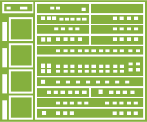













Juniper hardware
ACX Series universal access routers
BTI Packet optical products
ACX500
ACX710
ACX1000 ACX1100 ACX2100
BTI805
ACX500-0
BTI7802
BTI822
BTI7200
BTI7000
ACX2200
ACX4000
ACX5048
ACX5096
BTI7801
ACX5448
ACX5448-D
ACX6160
ACX6360
BTI7060
BTI7800-FMD96
BTI7814
ACX7000 Family - Cloud Metro routers
Cards
CX Series cellular broadband data bridge
ACX7020
ACX7024
ACX7024X
ACX7100-32C
ACX7100-48L
Physical Interfaces Cards (PICs)
FPCs, DPCs
CX111 LTE Broadband Modem
ACX7509
ACX7509 closed doors
ACX7332
ACX7348

Slide 26









Juniper hardware
CTP Series circuit to Packet platforms
EX Series ethernet switches
EX2200-C
EX2300-C
EX4600
EX2200-24P-10G, EX4300-24T, EX4300-24P, EX4300-24T-DC, EX4300-24F, EX4300 Line
EX Series, EX4300-48T, EX4300-48P
EXRPS
CTP150
CTP2008
EX8200
EX8208
CTP2024
EX8216
CTP2056 CTP Series
EX9214
EX9208
EX9204
EX9253
EX9251
E Series broadband services routers
E Series, VSR, BRAS, BSR

Slide 27

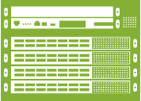




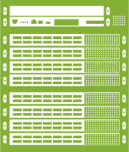




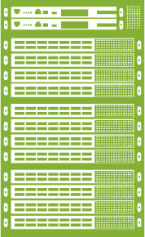






Juniper hardware
MX Series 3D universal edge routers
JSA Series secure analytics appliances
MX204
MX304
JSA7800
JRR200
JSA Virtual Appliance
MX480
MX10004
LN Series rugged secure routers
Juniper Cloud Interlink
MX240
LN1000
LN2600
NFX250
MX 960
MX10008
NFX
JCI Controller
NFX150
NFX150C
NFX350
JCI Gateway
Junos Space
MX10016
Junos Space
JA2500 Junos Space Appliance
MX2008
MX2010
MX2020

Slide 28
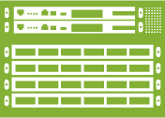






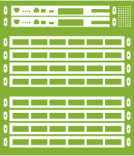






Juniper hardware
PTX/QFX
PTX Series packet transport routers
QFX Series
Optics
PTX1000
QFX5100-48S QFX5100-48T QFX5100-24Q
QFX5120-48Y QFX5120-32C
QFX5200-32C QFX5200-32C-S QFX5200-48Y
QFX5110-32Q QFX5110-48S
QFX5120-48YM QFX5120-48T
Unified PON
PTX10004 QFX10004
PTX10002-60C
QFX5100-96S
QFX5210-64C
QFX5210-64C-S
QFX5130-32CD
QFX5220-32CD
PTX10003-80C
PTX3000
PTX10008 QFX10008
QFX10002-36Q
QFX10002-72Q
QFX10002-60C
PTX10003-160C
QFX5220-128C
QFX5700
PTX5000
PTX10016 QFX10016

Slide 29















Juniper hardware
SRX Series Firewalls
SSR – Session Smart Router
SRX300
SRX550
SRX550-M
SRX4100
SRX4200
SSR120
SSR1200
SSR with Marvis
SSR with WAN Assurance
SRX320 SRX340
SRX4600
SSR130
SSR1300
SRX1500
SSR1400
SRX345
SRX 5400
SSR1500
SRX380
SRX 5600 5000 Line
Generic SSR
SRX 5800 Series
SRX Generic
SSR locked
HQ SSR
Branch SSR

Slide 30
Questions
Please contact the Juniper Brand Creative Team at brand@juniper.net

